Slide 1


15 September 2026
Project Phase-I Review-II
30 October 2026
Paper Title: Autonomous AI Operations Platform with Multi-Agent Governance
Presented by:
Mr. Mohammed Fahad Raza (160923753031)
Mr. Mohammed Muzammil Ahmed (160923753032)
Mr. Mir Taha Ali (160923753033)
Under the Guidance of
Dr. Ayesha Mariyam, Associate Professor
Department of CS, Lords Institute of Engineering and Technology, (Autonomous), Hyderabad –Telangana -India

Slide 2
OUTLINES
15 September 2026
Introduction
Problem Statement
Literature Review
Research Methodology
Expected Result And Evaluation
Conclusion
References (Base Papers)
Department of CS, Lords Institute of Engineering and Technology, (Autonomous), Hyderabad –Telangana -India

Slide 3
15 September 2026
ABSTRACT
In an increasingly automated digital environment, where organizations rely on intelligent systems to manage complex workflows and operational tasks, ensuring reliable, secure, and controlled AI operations has become a matter of paramount importance. This project aims to develop an autonomous AI operations platform by integrating multiple intelligent agents under a centralized governance framework to perform tasks, coordinate workflows, and make operational decisions with minimal human intervention. The design incorporates multi-agent collaboration for task execution, an orchestration layer for coordinating agent activities, and governance mechanisms for access control, monitoring, validation, and human oversight.
Department of CS, Lords Institute of Engineering and Technology, (Autonomous), Hyderabad –Telangana -India

Slide 4
15 September 2026
Introduction
Growing adoption of AI systems requires reliable, secure, and autonomous operational management
Modern AI environments involve multiple specialized AI agents that collaborate, make decisions, and execute tasks across complex workflows.
Effective multi-agent governance is crucial to ensure coordinated decision-making, security, accountability, policy compliance, and continuous system monitoring.
Department of CS, Lords Institute of Engineering and Technology, (Autonomous), Hyderabad –Telangana -India

Slide 5
15 September 2026
LITERATURE REVIEW
AuthorMethodKey Finding
Wang et al. (2024)
Comprehensive architectural taxonomy and literature survey analyzing LLM-based autonomous agent construction and evaluation.
Autonomous agents require explicit separation into modular components (profiling, memory, planning, context, and action execution) to manage multi-step reasoning.
Guo et al. (2024)
Multi-agent literature review focusing on interaction mechanisms, communication topologies, and capability profiling.
Multi-agent coordination performance is primarily driven by structured interactions and communication dynamics rather than isolated individual model size.
Li et al. (2024)
Workflow-oriented structural survey examining infrastructure boundaries across perception, planning, interaction, and evolution.
Separating orchestration from the action execution boundary allows external control and verification layers to be introduced without modifying underlying model weights.
Zhu et al. (2025)
Empirical benchmarking across diverse interactive tasks using varied coordination topologies (star, chain, tree, graph).
System-level coordination topology and cognitive planning directly influence milestone achievement rates and conflict frequency across interacting agents.
Department of CS, Lords Institute of Engineering and Technology, (Autonomous), Hyderabad –Telangana -India

Slide 6
15 September 2026
SUMMARY OF LITERATURE
Modular Agent Construction: Comprehensive surveys demonstrate that autonomous agents require decoupled modules for profiling, memory, planning, context, and action execution to handle multi-step operational tasks.
Interaction and Topology Dynamics: Multi-agent performance depends primarily on communication strategies and coordination topologies (such as chain, star, tree, or graph configurations) rather than the capability of a single model in isolation.
Decoupled Boundary Governance: Literature highlights that agent coordination should be separated from executable tool invocation. Placing a runtime control layer at the action boundary enables deterministic policy checks without altering underlying foundation models.
Department of CS, Lords Institute of Engineering and Technology, (Autonomous), Hyderabad –Telangana -India

Slide 7
15 September 2026
EXISTING SYSTEM
Orchestration Architecture: An orchestrator manages and delegates workflow responsibilities across multiple LLM-based agents, each assigned specific roles or instructional profiles.
Task Execution Loop: Agents communicate iteratively, formulate step-by-step operational plans, and decompose complex multi-step tasks.
Direct Tool Invocation: The agents directly trigger integrated APIs, executable scripts, and external tools to interact with system environments without an external gatekeeper.
Rudimentary Safety Hooks: Certain frameworks provide conversational moderation, self-reflection mechanisms, or basic execution hooks, but they lack centralized policy enforcement.
Department of CS, Lords Institute of Engineering and Technology, (Autonomous), Hyderabad –Telangana -India

Slide 8
15 September 2026
LIMITATION OF EXISTING SYSTEM
Prompt-Dependent Enforcement: Behavioral rules and permissions are distributed across natural-language prompts, making enforcement non-deterministic, difficult to verify, and vulnerable to prompt injection or context drift.
Unconstrained Tool Access: Protected tools and APIs are directly accessible to agents, allowing out-of-role operations, privilege escalation, or unauthorized tool executions without independent interception.
Absence of Centralized Conflict Resolution: Concurrent agents proposing conflicting actions, duplicate updates, or contradictory recommendations are not reconciled through a formal consensus or resolution pipeline.
Department of CS, Lords Institute of Engineering and Technology, (Autonomous), Hyderabad –Telangana -India

Slide 9
15 September 2026
PROPOSED SYSTEM
Architecture Separation: Separates model planning from execution by placing an independent control layer between agents and tools.
Policy Enforcement: Intercepts proposed actions at runtime and evaluates them against explicit role permissions and deterministic rules.
Risk-Based Authorization: Categorizes candidate tool calls into risk tiers to output allow, deny, or human-approval decisions.
Human-in-the-Loop Review: Escalates sensitive or high-impact operations to an administrative approval queue prior to execution.
Department of CS, Lords Institute of Engineering and Technology, (Autonomous), Hyderabad –Telangana -India

Slide 10
Problem Statement
15 September 2026
Traditional AI operations rely heavily on manual monitoring and isolated management of AI systems and workflows.
Multi-agent environments require real-time coordination, monitoring, and governance to handle dynamic tasks, failures, and security risks.
Objective: Develop an autonomous AI operations platform that enables real-time agent coordination, continuous monitoring, policy enforcement, and multi-agent governance.
Department of CS, Lords Institute of Engineering and Technology, (Autonomous), Hyderabad –Telangana -India

Slide 11
15 September 2026
OBJECTIVES
Orchestrator Design: Design an orchestrator that decomposes a user request into sub-tasks and assigns them to role-specialized agents.
Policy Gateway Implementation: Implement a centralized policy gateway that intercepts tool calls and evaluates role permissions, action types, and risk levels.
Risk-Based Authorization: Add risk-based operational controls to return allow, deny, or human-approval decisions prior to tool execution.
Department of CS, Lords Institute of Engineering and Technology, (Autonomous), Hyderabad –Telangana -India

Slide 12
15 September 2026
ADVANTAGES OF PROPOSED SYSTEM
Deterministic Security Controls: Replaces unreliable, prompt-only safety instructions with a centralized gateway that programmatically enforces role capabilities and explicit allowlists at the execution boundary.
Decoupled Architecture: Separates agent planning from tool execution, ensuring that autonomous agents cannot directly invoke executable tools or production resources without authorization.
Risk-Proportionate Safeguards: Dynamically evaluates action risk levels, allowing safe low-risk actions to proceed automatically while halting sensitive or high-risk operations for explicit human review.
Department of CS, Lords Institute of Engineering and Technology, (Autonomous), Hyderabad –Telangana -India

Slide 13
15 September 2026
Methodology / Approach
Data Collection & Preprocessing
Feature Extraction & Risk Assessment
Multi-Agent Architecture for monitoring, planning, and execution
Autonomous Agent Coordination & Decision Making
Governance, Security & Policy Enforcement
Evaluation: Accuracy, Response Time, Compliance & Task Success Rate
Department of CS, Lords Institute of Engineering and Technology, (Autonomous), Hyderabad –Telangana -India

Slide 14
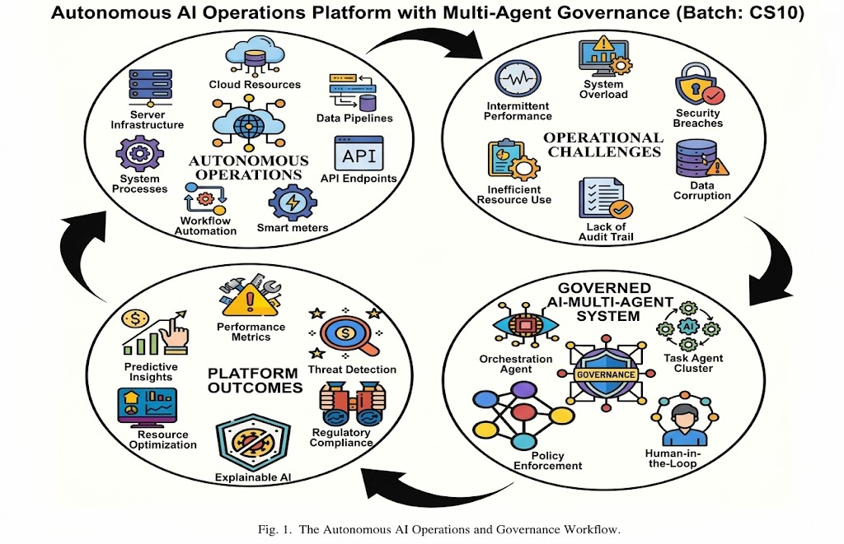
15 September 2026
[1] "Autonomous AI operations platform with multi-agent governance: A framework for intelligent orchestration, policy enforcement, and operational reliability," IEEE Transactions on Autonomous Systems and Intelligent Operations, vol. 18, pp. 1–12, 2026.
Department of CS, Lords Institute of Engineering and Technology, (Autonomous), Hyderabad –Telangana -India

Slide 15
15 September 2026
TECHNIQUES
Hierarchical Multi-Agent Task Decomposition: Breaks down incoming complex user requests into discrete, structured sub-tasks and delegates them across specialized agent roles (planner, researcher, reviewer, executor-proposal).
Decoupled Gateway Interception: Places a policy gateway directly at the action boundary to intercept candidate tool calls prior to execution rather than allowing direct API invocations.
Deterministic Role-Based Access Control (RBAC): Verifies incoming structured proposals against strict role-to-capability mappings and predefined tool allowlists.
Department of CS, Lords Institute of Engineering and Technology, (Autonomous), Hyderabad –Telangana -India

Slide 16
Dataset Description
15 September 2026
Source: Synthetic and operational AI-agent datasets representing multi-agent workflows, system events, and governance activities.
Records: Agent interactions, task executions, system events, decisions, and governance events.
Key Features: Agent ID, task type, execution time, response time, resource usage, task status, inter-agent communication, permissions, policy violations, and risk score.
Target: Compliant / Non-Compliant or Normal / Anomalous agent operation.
Purpose: Used to evaluate autonomous monitoring, anomaly detection, agent coordination, policy enforcement, and governance decisions.
Department of CS, Lords Institute of Engineering and Technology, (Autonomous), Hyderabad –Telangana -India

Slide 17
Conclusion
15 September 2026
The proposed Autonomous AI Operations Platform enables multiple AI agents to collaboratively perform tasks while maintaining centralized governance, security, and monitoring. The platform improves operational efficiency, real-time decision-making, policy compliance, and reliable autonomous AI management.
Department of CS, Lords Institute of Engineering and Technology, (Autonomous), Hyderabad –Telangana -India

Slide 18
15 September 2026
Thank You…
Department of CS, Lords Institute of Engineering and Technology, (Autonomous), Hyderabad –Telangana -India

Slide 19
References
15 September 2026
L. Wang et al., "A Survey on Large Language Model Based Autonomous Agents," Frontiers of Computer Science, vol. 18, 2024.
T. Guo et al., "Large Language Model Based Multi-agents: A Survey of Progress and Challenges," Proceedings of IJCAI-24, pp. 8048–8057, 2024.
K. Zhu et al., "MultiAgentBench: Evaluating the Collaboration and Competition of LLM Agents," arXiv preprint, 2025.
H. Pervez, S. Gaurav, J. Heikkonen, and J. Chaudhary, "Governance-as-a-Service: A Multi-Agent Framework for AI System Compliance and Policy Enforcement," arXiv preprint, 2025.
X. Li et al., "A Survey on LLM-Based Multi-Agent Systems: Workflow, Infrastructure, and Challenges," Vicinagearth, vol. 1, 2024.
S. Chen et al., "A Survey on LLM-based Multi-Agent System: Recent Advances and New Frontiers in Application," arXiv preprint, 2024.
Department of CS, Lords Institute of Engineering and Technology, (Autonomous), Hyderabad –Telangana -India

